Slide 1
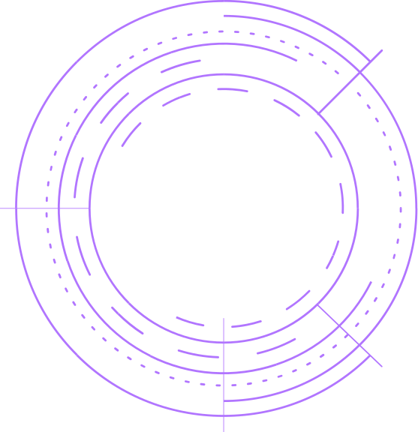
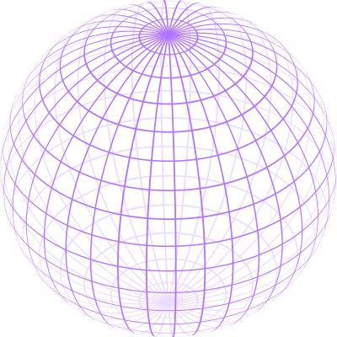

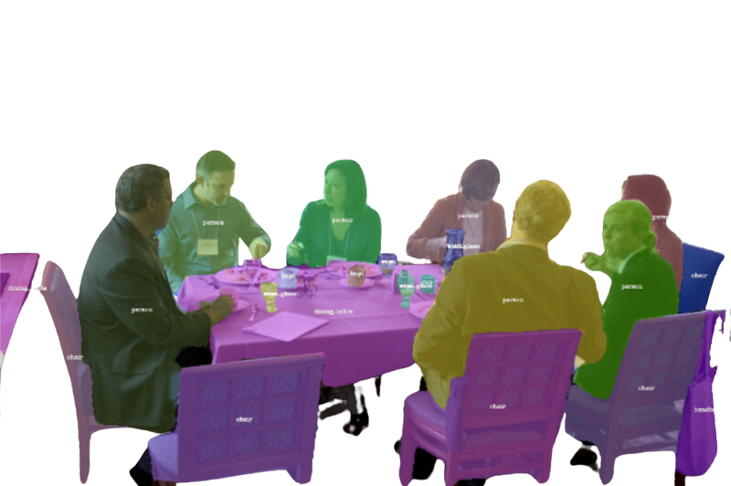
SEGMENTING OBJECTS BY LOCATIONS
SOLO V2 PAPER REVIEW
WHAT ARE THE FUNDAMENTAL DIFFERENCES BETWEEN OBJECT INSTANCES IN AN IMAGE?
ATANDA ABDULLAHI ADEWALE

Slide 2

ABSTRACT

Slide 3
ABSTRACT
NO ANCHOR BOX
no NORM
NO bounding box

Slide 4
ABSTRACT
NO ANCHOR BOX
no NORM
NO bounding box
DECOUPLED OBJECT MASK GENERATION

Slide 5
ABSTRACT
NO ANCHOR BOX
no NORM
NO bounding box
DECOUPLED OBJECT MASK GENERATION
MASK KERNEL PREDICTION

Slide 6
ABSTRACT
NO ANCHOR BOX
no NORM
NO bounding box
DECOUPLED OBJECT MASK GENERATION
MASK KERNEL PREDICTION
MASK FEATURE LEARNING

Slide 7
ABSTRACT
NO ANCHOR BOX
no NORM
NO bounding box
DECOUPLED OBJECT MASK GENERATION
MASK KERNEL PREDICTION
MASK FEATURE LEARNING
MATRIX
NMS

Slide 8
ABSTRACT
NO ANCHOR BOX
no NORM
NO bounding box
DECOUPLED OBJECT MASK GENERATION
MASK KERNEL PREDICTION
MASK FEATURE LEARNING
MATRIX
NMS
37.1% AP ON COCO

Slide 9
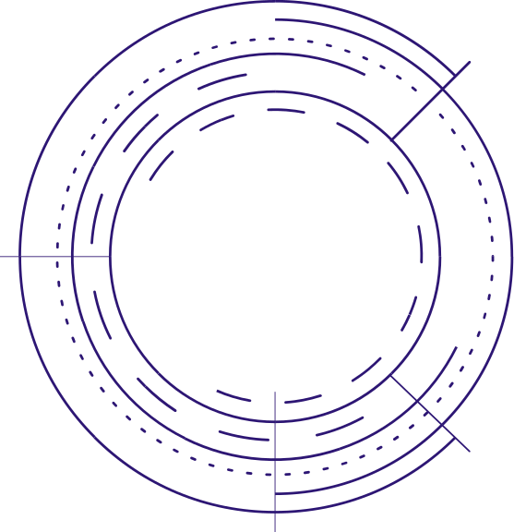

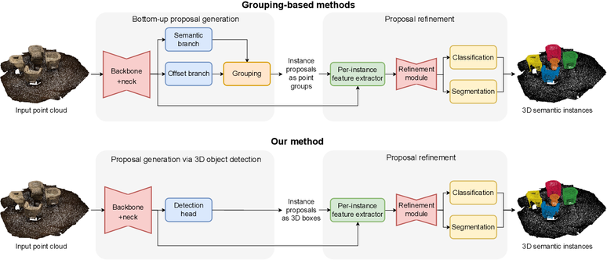
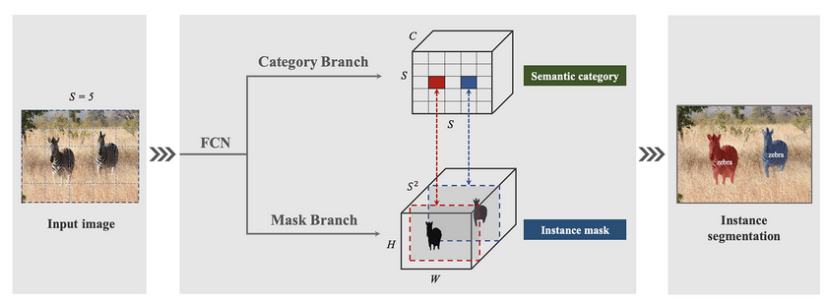
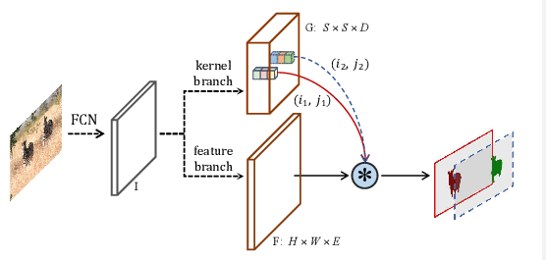
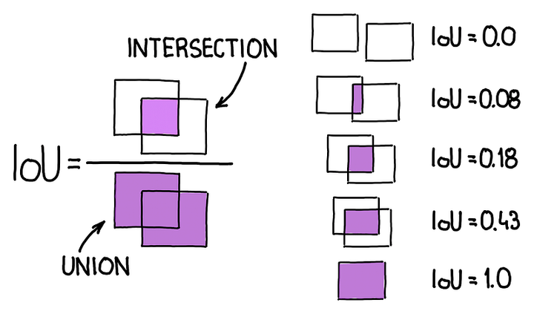
RELATED WORK
TOP-DOWN AND BOTTOM-UP INSTANCE SEGMENTATION METHODS
DIRECT METHODS (SOLO V1)
MATRIX NMS (FROM SOFT NMS)
DYNAMIC CONVOLUTION

Slide 10
RELATED WORK
TOP-DOWN AND BOTTOM-UP INSTANCE SEGMENTATION METHODS
DIRECT METHODS (SOLO V1)
MATRIX NMS (FROM SOFT NMS)
DYNAMIC CONVOLUTION

Slide 11
RELATED WORK
TOP-DOWN AND BOTTOM-UP INSTANCE SEGMENTATION METHODS
DIRECT METHODS (SOLO V1)
MATRIX NMS (FROM SOFT NMS)
DYNAMIC CONVOLUTION

Slide 12
RELATED WORK
TOP-DOWN AND BOTTOM-UP INSTANCE SEGMENTATION METHODS
DIRECT METHODS (SOLO V1)
MATRIX NMS (INSPIRED BY SOFT NMS)
DYNAMIC CONVOLUTION

Slide 13
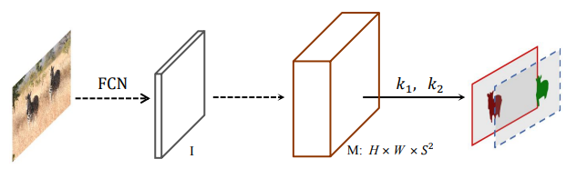
METHODS
SOLOV1 BOTTLENECKS LIMIT ITS PERFORMANCE:
INEFFICIENT MASK REPRESENTATION AND LEARNING.
NOT HIGH ENOUGH RESOLUTION FOR FINER MASK PREDICTION.
SLOW MASK NMS.
FIX
DIVIDE MASK LEARNING INTO TWO PARTS:
CONVOLUTION KERNEL LEARNING AND FEATURE LEARNING.
CONSTRUCT A UNIFIED AND HIGH-RESOLUTION MASK FEATURE
REPRESENTATION.
MATRIX NMS WAS PROPOSED.
SOLOV1
SOLOV2

Slide 14


METHODS
MASK KERNEL (G)
FINAL MASK (M)
FEATURE (F)
Resize Input Feature
Apply Convolutional Layers
Add Spatial Information by using CoordConv.
Share Weights Across Feature Levels
Predict D-dim. Output
Condition Weights on Locations
No Activation Function on Output
Apply Repeated Conv. to FPN (P2 to P5).
Add Group Norm and ReLU
Perform Bilinear Upsampling
Merge FPN Features
Final Convolution and Activation ReLU.
Integrate Normalized Pixel Coordinates
Use Accurate Position Information
MATRIX NMS
TRAINING LOSS

Slide 15
THANK YOU
Imagination is more important than knowledge.
ALBERT EINSTEIN

